Slide 1

Lukovsski Gleb
Valentin Gundorov
Ron Twito
Omer Zaadi

Slide 2
The Idea and the Motivation
The Goal: Our objective is to develop an intelligent and precised automated system capable of interpreting a course review and
assigning distinct labels. For that task, we need to determine whether there is added value in using a “smart”
model based on neural network and transformers, over a “dumber” one that use classic machine learning algorithms.
Motivation:
**Main motivation behind is saving Human Resources and Time:
- Short Response Time and immediate Feedback and Scalability
- Low Load on the Analysis Team
- Improving Decision-Making Processes and Educational Strategy
- Integration with Other Systems and APIs
**Consistency and Accuracy in Evaluation:
- Preventing Personal Biases, different evaluators may assign different meanings.

Slide 3
How we gonna do that? (High Level Plan)
Let’s explore what has been done in the field so far. Has anyone already done this or something similar? If so, what were the results?
Let`s start by creating two different datasets, the first one will be manually labeled and the second one labeled by Chatgpt. This way we can validate the problem of personal biases.
We`ll create two different models, a “smart” one and a “dumber”.
Then train and test each of the models separately on each dataset.
Finally, we will compare results. Are they satisfying or not? Which one is better? Is there added value using the “smart” model? What and how can be improved?
At the end, evaluation using GPT 4o. Let`s see how a smart well trained but simultaneously untrained model for that specific task, will behave.

Slide 4
Prior Art
Criteria | Paper 1 | Paper 2 | Paper 3
Source/Title | “Sentiment Analysis of Student Feedback Using Machine Learning and Lexicon-Based Approaches”, 2017. Institute of Business Administration(IBA). https://www.researchgate.net/publication/319052290_Sentiment_analysis_of_student_feedback_using_machine_learning_and_lexicon_based_approaches | MF-SET: A Multitask Learning Framework for Student Evaluation of Teaching (2023), link 2 tasks: 1.. Tag three labels—“intellectual challenge offered,” “average recommendation,” and “average learning guidance”—on a scale of 1–3. 2. Assign the response to the aspects it refers to. | Deep Learning for Opinion Mining and Topic Classification of Course Reviews. https://arxiv.org/pdf/2304.03394
Approach/Model | TF-IDF + features Machine Learning models: SVM and Random Forest | BERT and GPT-3 | RoBERTa, BERT, XLNet, CNN, LSTM, SVM, Naïve Bayes, k-NN
Data | 1230 open-ended student feedback entries. 1 label, manually labeled as Positive, Negative, or Neutral | 3500 (BERT) (3 labels: Intellectual Challenge, Recommendation, Learning Guidance) ( 3 values -Needs Improvement, Satisfactory, Great ) 2000 (GPT-ADA): (9 labels, belongs or not) | The resulting dataset had 10,610 reviews (text comments). The review text length ranges from a minimum of 2 words to a maximum of 4,219 words, with an average of 245 words and a standard deviation of 251.
Metrics | Accuracy, F1-score, precision, recall. | Mission 1: Accuracy, macro AVG, weighted AVG Mission 2, Krippendorff's Alpha | Sentiment classification: RoBERTa: Accuracy 95.5%, F1-macro 84.7% CNN (pretrained): Accuracy 92.1%, F1-macro 82.4% Topic classification: SVM: Accuracy 79.8%, F1-macro 80.6% BERT (maxlen=100): Accuracy 79.9%, F1-macro 82.5%
Results | Best Result: TF-IDF + Random Forest– 0.934 Accuracy. | BERT achieved good accuracy ≈ 0.89. GPT 3 achieved low results - Krippendorff's Alpha: 62.27% due to dataset labeling inconsistency | Transformer models (esp. RoBERTa) excel at sentiment classification Traditional models (esp. SVM) best for topic classification Pre-trained embeddings and higher maxlen improve results Models can support educators in analyzing feedback efficiently

Slide 5
Preprocessing
Data set creation:
- Generating mini datasets, with ChatGPT, of 3500 labeled course reviews using
distinct, carefully crafted prompts for each individual label at each step, as well as combinations of labels and then
combining them together.
- Downloading 1000 unlabeled course reviews from Kaggle.
Labeling:
- Manually labelling the 1000 unlabeled reviews by 4 different persons. Each persom, labels 250 reviews.
- A random manual manual check of each mini dataset created by ChatGPT to assess the quality of the data
generated at different stage.
Models: Choosing the following models to compare: TF-IDF with Naïve Bayes VS BERT
- Each model will be trained separately on these two datasets.
- For each model, a mechanism was defined to identify the optimal values of the three most
influential hyperparameters.
Metrics: Measuring the accuracy of guessing all 4 labels correctly.
Evaluation: GPT 4o.

Slide 6
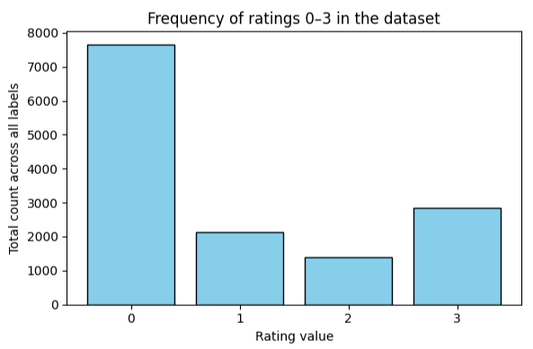
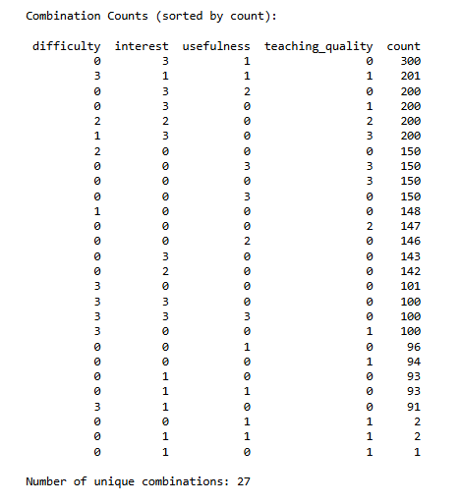
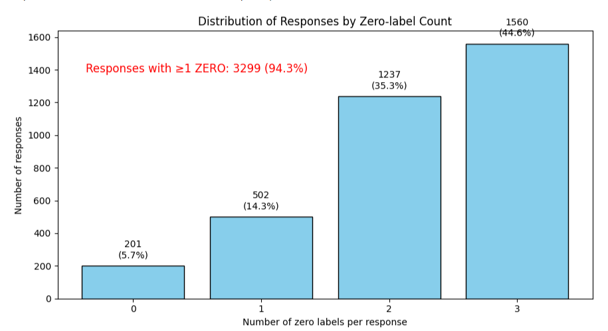
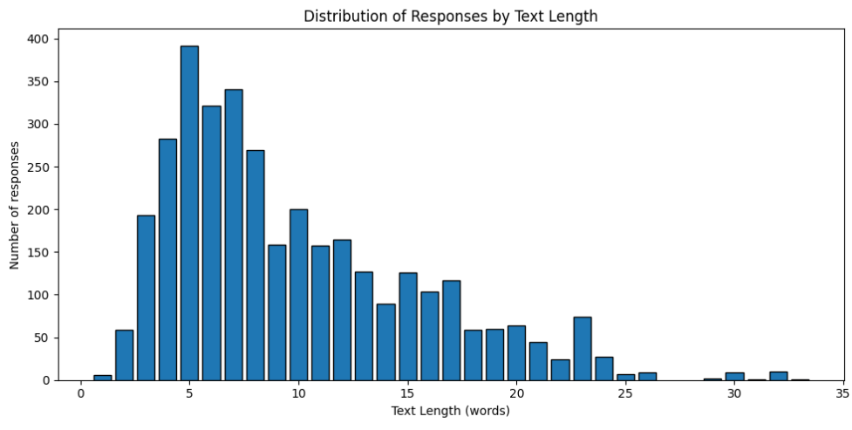
Exploration of DataSet.
Dataset:
- Around 27 different combinations of labelization.
- The most dominant value is 0, around 60% of the reviews had at least one 0 label.
- Low number of reviews with no 0 labelization, only 200 reviews.
- The shorter the review, the higher the likelihood that at least one label will be 0.
- Average review length is: 9.79 words. The median review length is: 8 words.
- Total reviews with 5 words or fewer: 933 reviews.

Slide 7
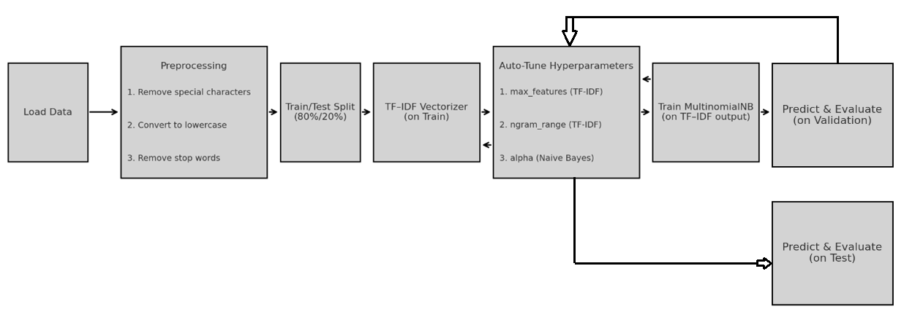
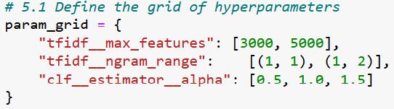
TF-IDF with NAÏVE BAYES

Slide 8
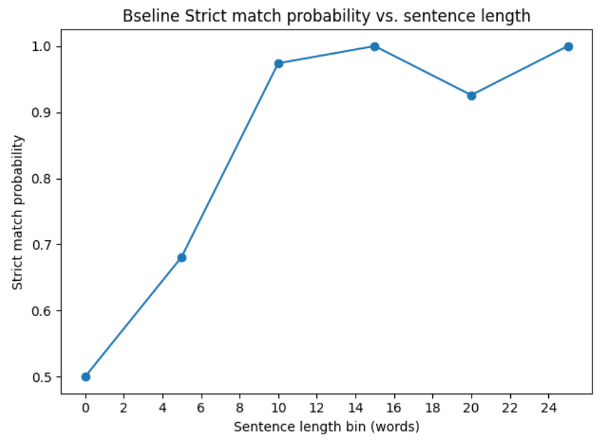
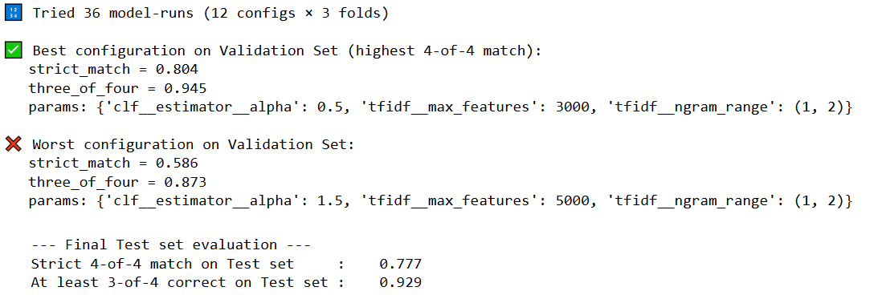
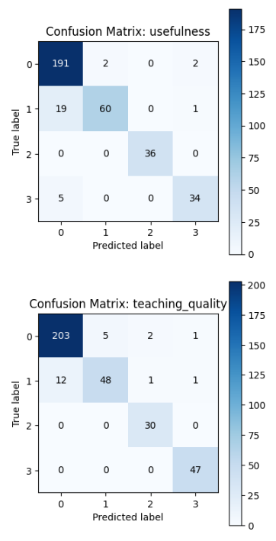
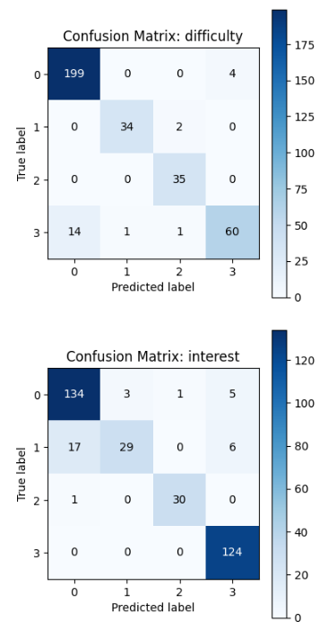
Exploration of Baseline Results.
Results:
- Using the manual dataset, achieved extremely low accuracy of 4 out of 4, around 0.3.
- Using GPT`s dataset, worst configuration of Hyper parameters achieved an accuracy of 0.53
guessing 4 out of 4 .
- Using GPT`s dataset, best configuration of Hyper parameters achieved an accuracy of
0.8 and 0.77(val. and eval. Sets) guessing 4 out of 4 and > 0.9 for each label separately.
- Accuracy exceeding 90% is achieved when a response comprises at least ten words.
- Highly failed at guessing : Usefulness score #1 - 30% failure, difficulty score #3 - 25% failure, teaching quality score #1 - 20% failure,
interest score #1 - 60% failure.

Slide 9
Baseline Conclusions
Dataset Labeling Inconsistency: People labeled the same review in different ways. We need clear, consistent rules for labeling. The Use of the manually labeled dataset should be rejected.
Review Length: The baseline model’s ability to identify all four labels decrease drastically as sentences become shorter.
Class Balance: ChatGPT`s dataset is unbalanced. Too much reviews with "0” labelization, and very low number of reviews with no “0” labelization. Adding non “0” labelized reviews, may increase the accuracy.
The model struggled to detect the score “1” and instead heavily biased toward labeling that class as “0.”
The model has a strong tendency for the “difficulty” label to be predicted as 0 when the true score was 3.
Overall, the results of the baseline are pretty descent with 77% accuracy.

Slide 10
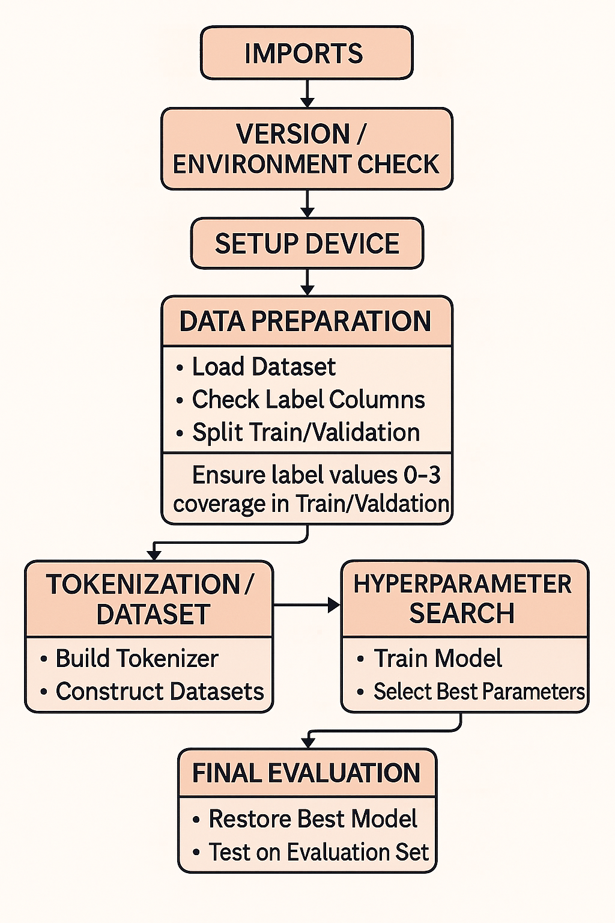
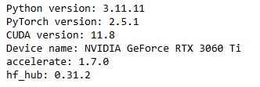
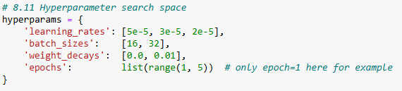
Bert
Setup configuration:
Dataset: Manually dataset rejected, Olny GPT`s 3500 dataset was used.
72% train, 8% validation, 20% Test set
Bert version: “Bert-base-multilingual-cased”
- 4 Linear Classification Head on Top of a Pre-trained BERT.
- Label Coverage Splitting - “Guarantees each label value (0–3)
appears in every split (Train, Validation, Test) via stratified and iterative sampling.
- Performs a grid search over learning rate, batch size, weight decay and epochs to
identify the best model configuration, then uses those optimal parameters to
evaluate performance on the evaluation set.

Slide 11
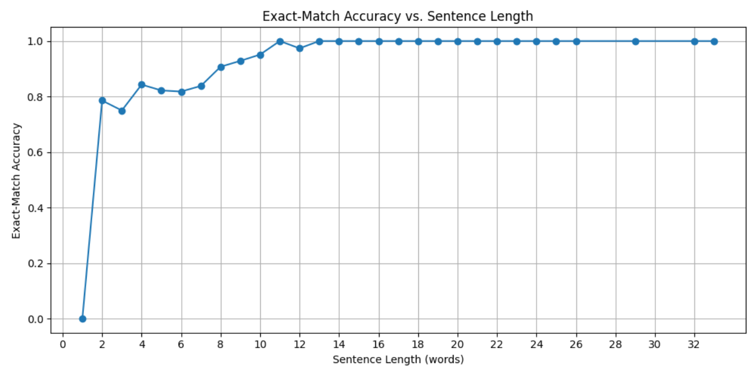
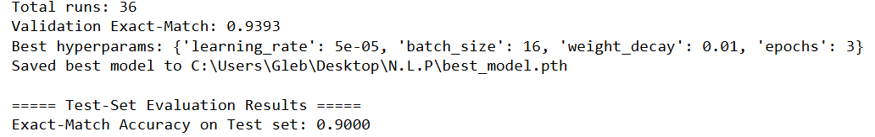
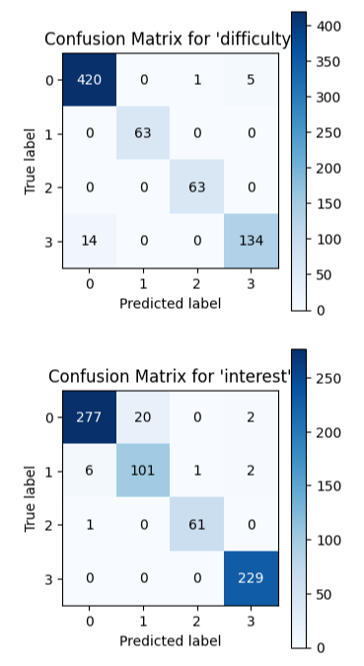
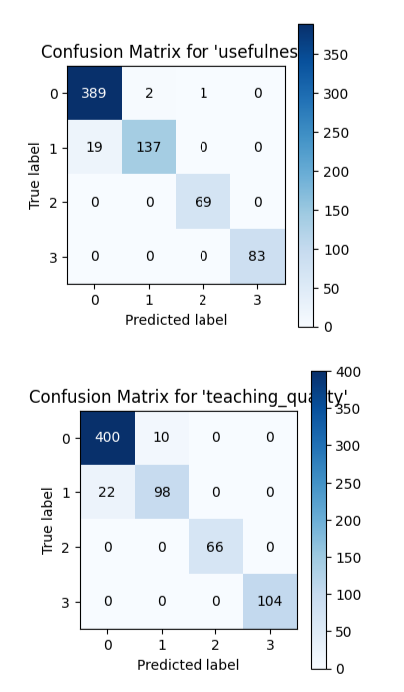
Bert Results
Bert Accuracy: 90%.
BERT performed much better when the reviews were short.
A slight tendency to assign a score of “0” when the true label is “1”.
The BERT model also had some difficulty correctly identifying a score of 3 for the “difficulty” label and tended to assign it a score of 0.

Slide 12
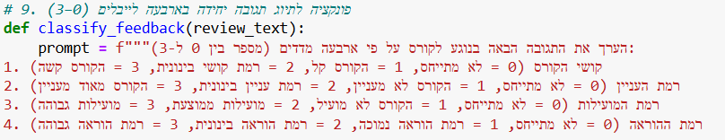
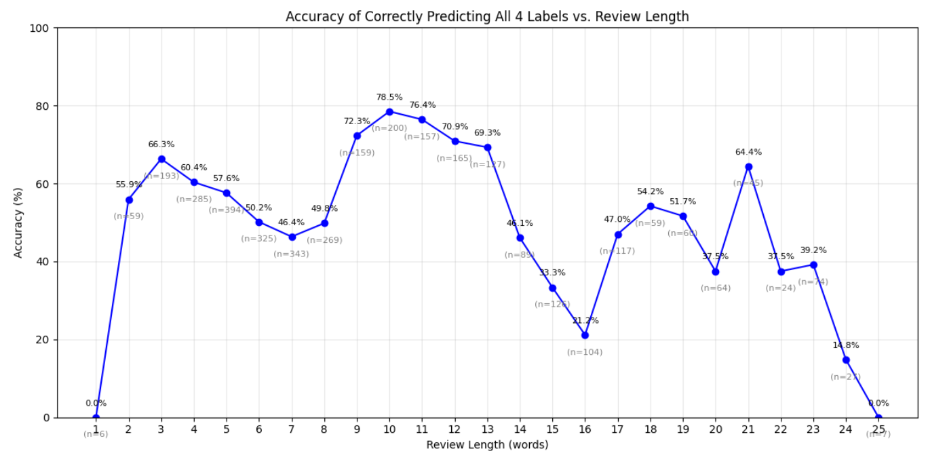
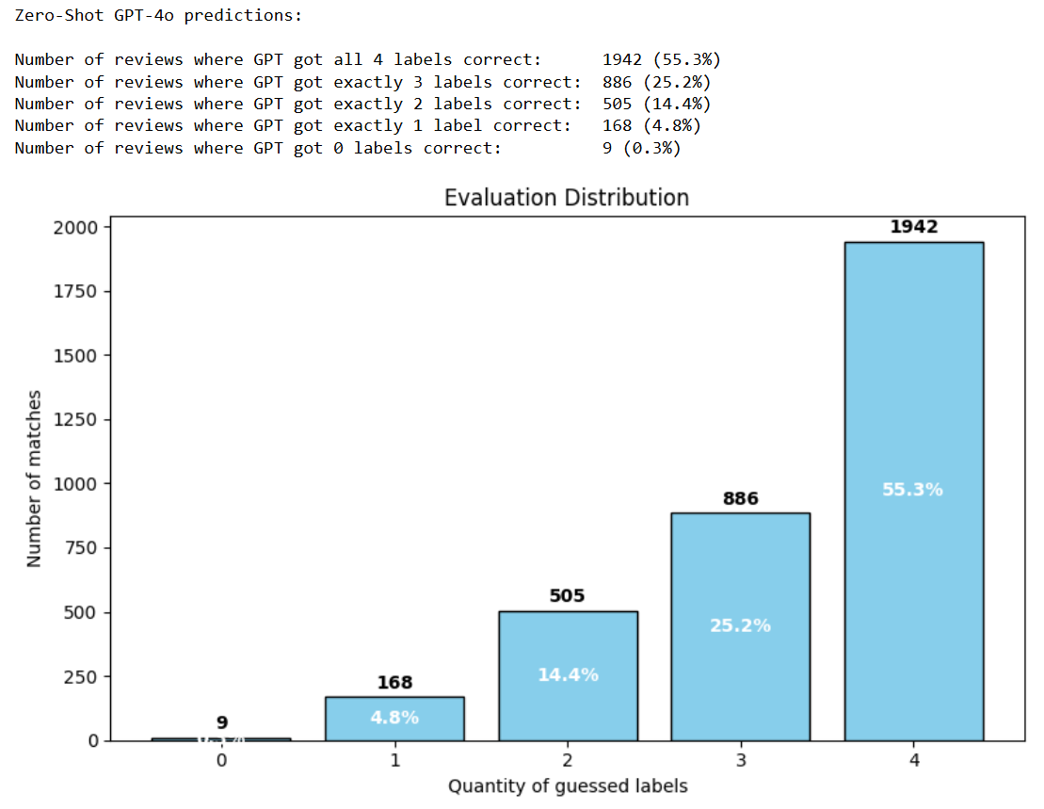
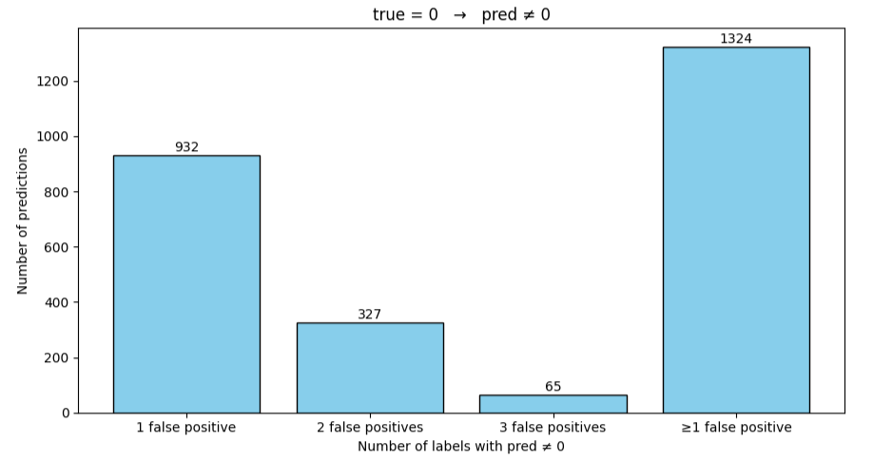
Bert Evaluation using GPT 4o
Model: GPT 4o
Dataset: The original dataset, 3500 reviews, was sent for evaluation.
GPT 4o Accuracy: 55%.
A drastic tendency to assign a score of “0” to labels whose true value was non-zero.
No clear relationship can be inferred between sentence length and the correct identification of all four labels.
A low tendency to assign a score of “0” to a label when its true value was ≠ 0.

Slide 13
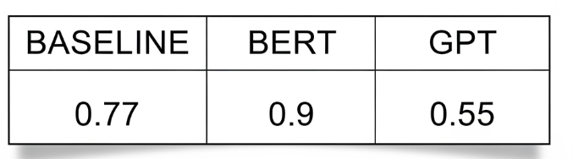
Conclusions:
The first and must step is: establishing a consistent labeling policy when labeling the dataset.
As with the BASELINE model, BERT also identified the labels more accurately when the word length was ten words or more.
In both model`s confusion matrices, there were misclassifications across all labels: whenever the true label was 1, both models tended to predict 0. Additionally, both models tended to predict a 0 for the “difficulty” label when the true score was 3. This tendencies were far more pronounced in the baseline model and noticeably reduced in the BERT model.
An off-the-shelf AI model not fine-tuned for this task will underperform. The primary culprit is inconsistency: every person or system applies its own internal logic or pattern, so different models—or even different people—will interpret the same review in different ways.
In summary, both the Baseline and BERT models achieved strong results, with BERT outperforming the Baseline. To improve and optimize the model, focus should be placed on enhancing detection results for shorter responses. It is recommended to prepare an additional dataset, a much bigger one that contain short responses only and establish a consistent labeling policy for cases where a response does not directly refer to a specific label but can still yield a non-zero score for that label.
Overall, Bert achieved an excellent accuracy of ≈ 90%, that`s a SUCCESS!!!

Slide 14
